Slide 1
HITECH overview
First Part strengthened HIPAA laws
Second part modernized health care infrastructure – move toward electronic medical records
Financial incentives created to push this modernization forward called meaningful use

Slide 2
Concept of Meaningful Use Rested on the “5 Pillars” of Health Outcomes policy priorities:
Improving quality, safety, efficiency, and reducing health disparities
Engage patients and families in their health
Improve care coordination
Improve population and public health
Ensure adequate privacy and security protection for personal health information

Slide 3
Meaningful use and Stimulus $
2 payment programs one thru Medicare and the other thru Medicaid
  Providers could only submit for incentive payment from one program
  Payor mix analyzed to determine where greatest benefit was attained.
Incentive payments began in 2011
Penalties began in 2015 payment reductions 99%>2016 98%>2017 and thereafter 97%
Notes:
Penalties…md’s would only be getting 99% of payment then 98%....etc

Slide 4
Overview of Meaningful Use
Total of $28B in HIT Funding
$2B for HIT infrastructure and adoption
  administration, planning, adoption assistance, education and loan program.
$26B for Medicare/Medicaid payment incentives for “meaningful use” of certified EHR technology
  “Meaningful Use” includes the use of a certified EHR technology that can provide for exchange of health information and reporting of quality measures.
Notes:
There were 3 stages of meaningful use

Slide 5
Grant and Loan Funding for HIT
HIT Infrastructure Grants
  Fund specific areas of HIT including adoption for providers not eligible for incentive payments
HIT Implementation Assistance
  Funding for an HIT Research Center
  Funding for HIT Regional Extension Centers
    Up to 4 years of funding and covering up to 50% of capitol and operating costs
State Planning and Implementation Grants
  Funding to expand health information exchange
  Requires state to match federal funds

Slide 6
Grants and Loan Funding for HIT
State Loan Program for Adoption
  Funding for establishing programs for purchase of technologies, training, upgrades, etc.
  Requires state to match federal funds
Funding for Clinical Education
  Funding to universities for development of curricula to integrate HIT into clinical education
Funding for Informatics Education Programs
  Funding for universities to establish and expand medical informatics programs
Notes:
Had to fund the health IT.
Clinical edu….people needed to learn how to use this, they were used to using paper.
People who were going to assist at quality reporting and initiatives.

Slide 7
Who Qualifies?
Medicare
  Section D Hospitals (excludes rehab, psych, cancer, etc.)
  Critical Access Hospital
Medicaid
  Acute care hospitals with 10% Medicaid volume
  Children’s hospitals
  Year one must be EHR user or working towards adoption of EHR
  After year one must be meaningful user
Notes:
Figured that hospitals would be the leaders bc they had the money and the man power to lead this
Critical access hospital….in very rural settings and has 100 beds but treat everyone in the area b/c would be the only hospital around

Slide 8
Medicare Incentive payments - hospitals
Medicare Formula
The Product of three factors:
An Initial Amount
The Medicare Share
A Transition Factor applicable to the payment year
Data from most recently filed 12 month cost report used
Notes:
Don’t have to memorize…

Slide 9
Example hospital (Benz hospital)
10,000 total discharges in most recent cost report
4,000 Medicare (Part A and Part C combined) discharges
1,000 Medicaid discharges
$100,000,000 Total charges in most recent cost report
$7,000,000 in charity care in most recent cost report
2014 First year eligible for incentive payment
Amazingly, all data was exactly the same for cost reports in 2013, 2014 and 2015

Slide 10
Initial amount calculation - Hospitals
Type of Hospital | Hospitals with 1,149 or fewer discharges during the payment year | Hospitals with at least 1,150 but no more than 23,000 discharges during the payment year | Hospitals with 23,001 or more discharges during the payment year
Base Amount | $2,000,000 | $2,000,000 | $2,000,000
Discharge-Related Amount | $0 | $200 x (n – 1,149) (n is the number of discharges during the payment year) | $200 x (23,001 – 1,149)
Total Initial Amount | $2,000,000 | Between $2M and $6,370,400 depending on the number of discharges | Limited by law to $6,370,400

Slide 11
Benz hospital initial amount
$2,000,000 + $200 x (10,000 – 1149)
= $2,000,000 + $200 x 8851
= $2,000,000 + $1,770,200
= $3,770,200

Slide 12
The Medicare share - hospitals
# of IP Part A Bed days + # of IP Part C Days) /
Total IP Bed Days x ((Total Charges – Charges Attributable to charity care total charges) / Total hospital charges))

Slide 13
Benz Hospital Medicare Share
4000 / 10,000 x ((100,000,000 – 7,000,000)/100,000,000)
= 4000 / 10,000 x (93,000,000 / 100,000,000)
= 4000 / 10,000 x .93
= 4000 / 9,300
= .43 (43%)

Slide 14
Transition factor - hospitals
Fiscal Yr of 1st Payment
 | 2011 | 2012 | 2013 | 2014 | 2015
2011 | 1.00 | XXXXXXXX | XXXXXXXX | XXXXXXXX | XXXXXXXX
2012 | 0.75 | 1.00 | XXXXXXXX | XXXXXXXX | XXXXXXXX
2013 | 0.50 | 0.75 | 1.00 | XXXXXXXX | XXXXXXXX
2014 | 0.25 | 0.50 | 0.75 | 0.75 | XXXXXXXX
2015 | XXXXXX | 0.25 | 0.50 | 0.50 | 0.50
2016 | XXXXXX | XXXXXXXX | 0.25 | 0.25 | 0.25

Slide 15
Benz Hospital transition factor
2014: 0.75
2015: 0.50
2016: 0.25

Slide 16
Benz hospital total incentive payments
Year 1: Initial amount x Medicare Share x Transition Factor
Year 1 = $3,770,200 x 0.43 x 0.75 = $1,215,889.50
Years 2 and 3: Initial amounts and Medicare Share the same because data was same
Year 2 = $3,770,200 x 0.43 x 0.50 = $810,592.00
Year 3 = $3,770,200 x 0.43 x 0.25 = $405,296.50
Total Payments = $2,431,778.00 over 3 years

Slide 17
Medicare Incentive payments and penalties - Hospitals
Medicare Incentive Payments
Paid as a lump sum or periodic lump sums
Hospitals that first qualify in 2014 can receive only 3 years of payment beginning with year two transition factors
Hospitals that first quality in 2015 can receive only 2 years of payment beginning with year 3 transition factor
No payments after 2016
Medicare Penalties
2015: hospital that did not qualify as meaningful users are subject to penalties:
  Inpatient Prospective Payment System increases reduced by following percentages:
  25% in 2015 for 2013 reporting period
  50% in 2016 for 2014
  75% in 2017+ for 2015
  2018: moved to promoting interoperability
Notes:
The later you started the less reimbursement you got

Slide 18
Hospitals can apply for hardship exceptions to avoid penalties
Infrastructure — Eligible hospitals must demonstrate that they are in an area without sufficient internet access or face insurmountable barriers to obtaining infrastructure (e.g., lack of broadband).
New eligible hospitals — Eligible hospitals with new CMS Certification Numbers (CCNs) that do not have the time to become meaningful EHR users can apply for an exception for one full cost reporting period.
Unforeseen Circumstances — Examples may include a natural disaster or other unforeseeable barriers.
EHR Vendor Issues — an eligible hospital’s EHR vendor was unable to obtain certification, or the hospital was unable to implement meaningful use due to EHR certification delays.

Slide 19
Medicaid Incentive Payments – Hospital
Statute authorizes states to make incentive payments to hospitals to encourage the adoption and use of EHR’s
  Incentive payments funded 100% FMAP (90% for state administration) subject to caps:
    Aggregate 4 year cap = Medicare formula using Medicaid days in the share calculation
    Annual cap = 50% of aggregate cap
    Two year cap = 90% of aggregate cap
  First payment year incentives may be paid to providers who engage in efforts to adopt, implement or upgrade certified EHR technology
  After first year, providers must be meaningful users to qualify for incentive payments
  To find out how New York ran it’s EHR Incentive Program visit https://www.health.ny.gov/health_care/medicaid/redesign/ehr/

Slide 20
HIT Incentive payment - physicians
Hospital based physicians are NOT eligible for HIT incentive payments
  Physicians that furnish substantially all services (inpatient and outpatient) in a hospital setting using the facilities and equipment, including EHR of the hospital
Qualifying non-hospital physicians are eligible for Medicare or Medicaid HIT incentive payments but not both

Slide 21
Medicare Payment – eligible professionals (Eps)
Medicare HIT incentive payments based on 75% of estimated allowed charges for all covered services
    Capped at specific amounts each year up to up to $44,000 in total
    Incentive payments increased by 10% for services provided in designated health professional shortage area
Incentive payments begin in 2011
    Maximum period of benefit is 5 years
    Final year to receive 5 years of benefits is 2012

Slide 22
Medicare Payment - physicians
Max payout / Year | First Year of participation | First Year of participation | First Year of participation | First Year of participation
 | 2011 | 2012 | 2013 | 2014
2011 | $18,000
2012 | $12,000 | $18,000
2013 | $7840 | $11,760 | $14,700
2014 | $3920 | $7840 | $11,760 | $11,760
2015 | $1960 | $3920 | $7840 | $7840
2016 |  | $1960 | $3920 | $3920
Total | $43,720 | $43,480 | $38,220 | $23,520

Slide 23
Medicare penalties – physicians
Beginning in 2015, non-hospital based physicians that are not meaningful users of HIT will be subject to reductions in the Physician Fee Schedule amount
Payment Year | Percentage Point Reduction to the Physician Fee Schedule Amount
2015 | 1.0%
2016 | 2.0%
2017 and subsequent years | 3.0%
Notes:
Payments will be ceased but penalties may continue

Slide 24
Avoiding penalties through hardship exceptions - physicians
Lack of Infrastructure: Eligible professionals must demonstrate that they are in an area without sufficient internet access or face insurmountable barriers to obtaining infrastructure (e.g., lack of broadband).
Extreme and Uncontrollable Circumstances: Examples may include a natural disaster or other unforeseeable barrier.
  EHR Vendor Issues: The eligible professional’s EHR vendor was unable to obtain certification or the eligible professional switched vendors.
Patient Interaction:
  Lack of face-to-face or telemedicine interaction with patient
  Lack of follow-up need with patients
Practice at Multiple Locations: Lack of control over availability of CEHRT for more than 50% of patient encounters.

Slide 25
Medicaid Payments - physicians
Eligibility requirements for Medicaid HIT incentive payments
  At least 30% of patient volume attributed to Medicaid patients (20% for pediatricians)
Medicaid HIT incentive payments are designed to reimburse for the cost associated with the purchase of certified EHR technology
  Up to 85% of the net average allowable costs
  Can include costs associated with maintenance and training
  First year payment cannot exceed $25,000 (Secretary of HHS has the authority to reduce this amount)
  Payments are available for up to five additional years capped at $10,000/year
  Payments can begin no later than 2016

Slide 26
Student presentations

Slide 27
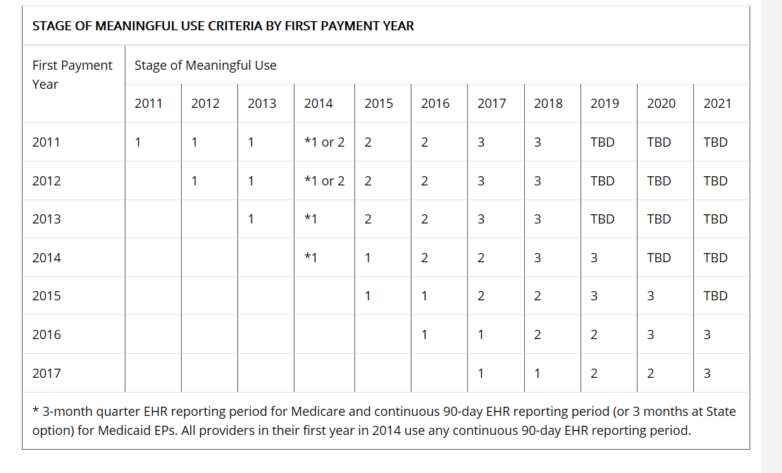
Meaningful use Timeline

Slide 28
Three stages in meaningful use – original regulations
Stage 1
  Reporting period 90 days for first year / 1 year subsequently
  May be yes/no or numerator/denominator
  Includes core objectives, objectives from menu set and clinical quality measures

Slide 29
Hospital stage 1 core objectives
Computerized provider order entry (CPOE) –30% of unique patients w/ at least 1 medication in their medication list
Drug-drug and drug-allergy interaction checks
Record demographics – 50% of all unique patients have demographics such as gender, race, ethnicity, birth date recorded as structured data
Implement one clinical decision support rule
Maintain up-to-date problem list of current and active diagnoses
Maintain active medication list
Maintain active medication allergy list

Slide 30
Hospital stage 1 core objectives
Record and chart changes in vital signs
Record smoking status for patients 13 years or older
Report hospital clinical quality measures to CMS or States
Provide patients with an electronic copy of their health information, upon request
Provide patients with an electronic copy of their discharge instructions at time of discharge, upon request
Capability to exchange key clinical information among providers of care and patient-authorized entities electronically
Protect electronic health information

Slide 31
Hospital stage 1 Menu Set objectives
Drug-formulary checks
Record advanced directives for patients 65 years or older
Incorporate clinical lab test results as structured data
Generate lists of patients by specific conditions
Use certified EHR technology to identify patient-specific education resources and provide to patient, if appropriate
* At least 1 public health objective must be selected.

Slide 32
Hospital stage 1 Menu Set objectives
Medication reconciliation
Summary of care record for each transition of care/referrals
Capability to submit electronic data to immunization registries/systems*
Capability to provide electronic submission of reportable lab results to public health agencies*
Capability to provide electronic syndromicsurveillance data to public health agencies*
* At least 1 public health objective must be selected.

Slide 33
Hospital stage 1 Clinical quality measure – Must complete all
Emergency Department Throughput –admitted patients Median time from ED arrival to ED departure for admitted patients
Emergency Department Throughput –admitted patients –Admission decision time to ED departure time for admitted patients
Ischemic stroke –Discharge on anti-thrombotics
Ischemic stroke –Anticoagulation for A-fib/flutter
Ischemic stroke –Thrombolytic therapy for patients arriving within 2 hours of symptom onset
Ischemic or hemorrhagic stroke –Antithrombotic therapy by day 2
Ischemic stroke –Discharge on statins

Slide 34
Hospital stage 1 Clinical quality measure – Must complete all
Ischemic or hemorrhagic stroke –Stroke education
Ischemic or hemorrhagic stroke –Rehabilitation assessment
VTE prophylaxis within 24 hours of arrival
Intensive Care Unit VTE prophylaxis
Anticoagulation overlap therapy
Platelet monitoring on unfractionated heparin
VTE discharge instructions
Incidence of potentially preventable VTE

Slide 35
Meaningful use Stage 1
To find measures for all objectives and physician objectives, visit https://www.cms.gov/Regulations-and-Guidance/Legislation/EHRIncentivePrograms/downloads/MU_Stage1_ReqOverview.pdf

Slide 36
Assign Student Presentations
Student-led discussion of assigned reading (2)​
Student article presentation (4)​

Slide 37
Meaningful use stage 2
Many objectives are the same, but threshold requirements went up
  Example: Record smoking status for patient 13 and older went from >50% to >80%
More core objectives and fewer menu objectives
More Clinical Quality Measures must be reported
Must receive secure messages from more than 5% of patients and a similar percentage of patients must have online access to their health information
  Excluded for providers that work in area with limited broadband availability

Slide 38
Modified stage 2
Key Concepts for the EHR Incentive Programs in 2015 through 2017
  Restructured Stage 1 and Stage 2 objectives and measures to align with Stage 3:
    10 objectives for EPs, including one consolidated public health reporting objective with measure options
    9 objectives for eligible hospitals and CAHs, including one consolidated public health reporting objective with measure options
  Starting in 2015, the EHR reporting period aligns with the calendar year for all providers

Slide 39
Modified stage 2
Key Concepts for the EHR Incentive Programs in 2015 through 2017
  Changed the EHR reporting period in 2015 to 90 days to accommodate modifications to meaningful use
  Modified Stage 2 patient engagement objectives that require “patient action”
  Streamlined the program by removing redundant, duplicative, and topped out measures
  CQM reporting for both (EPs) and eligible hospitals/CAHs remains as previously finalized

Slide 40
Meaningful use stage 3
Renamed from EHR Incentive Programs to Promoting Interoperability Programs
Must attest to a single set of measures
Must attest to a single set of 6 objectives
Must use EHR technology certified to 2015 Edition

Slide 41
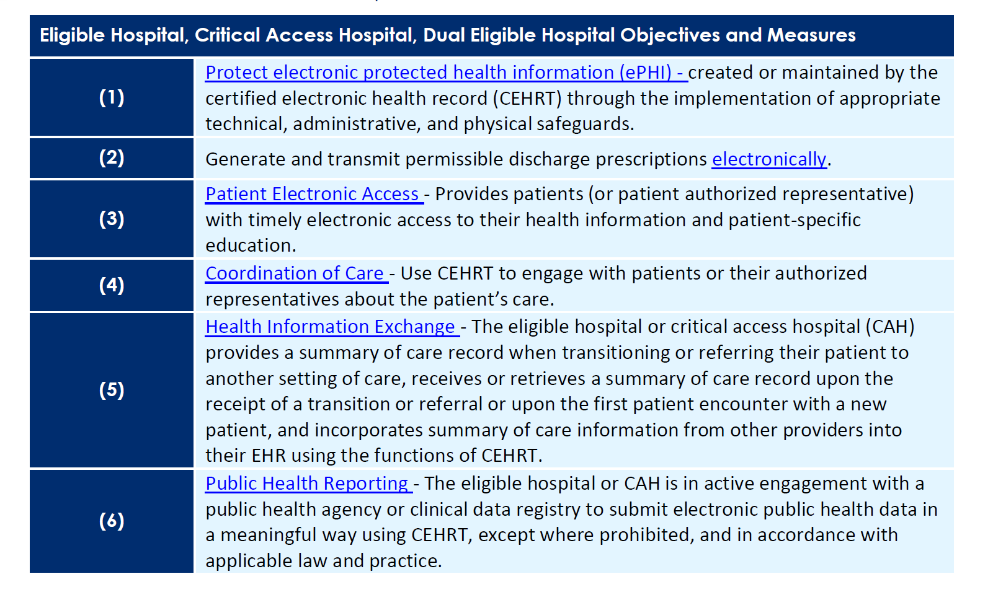
Meaningful use stage 3 – 6 Objectives

Slide 42
Comparison tool for modified stage 2 and stage 3
http://www.dhs.pa.gov/cs/groups/webcontent/documents/document/c_253196.pdf

Slide 43
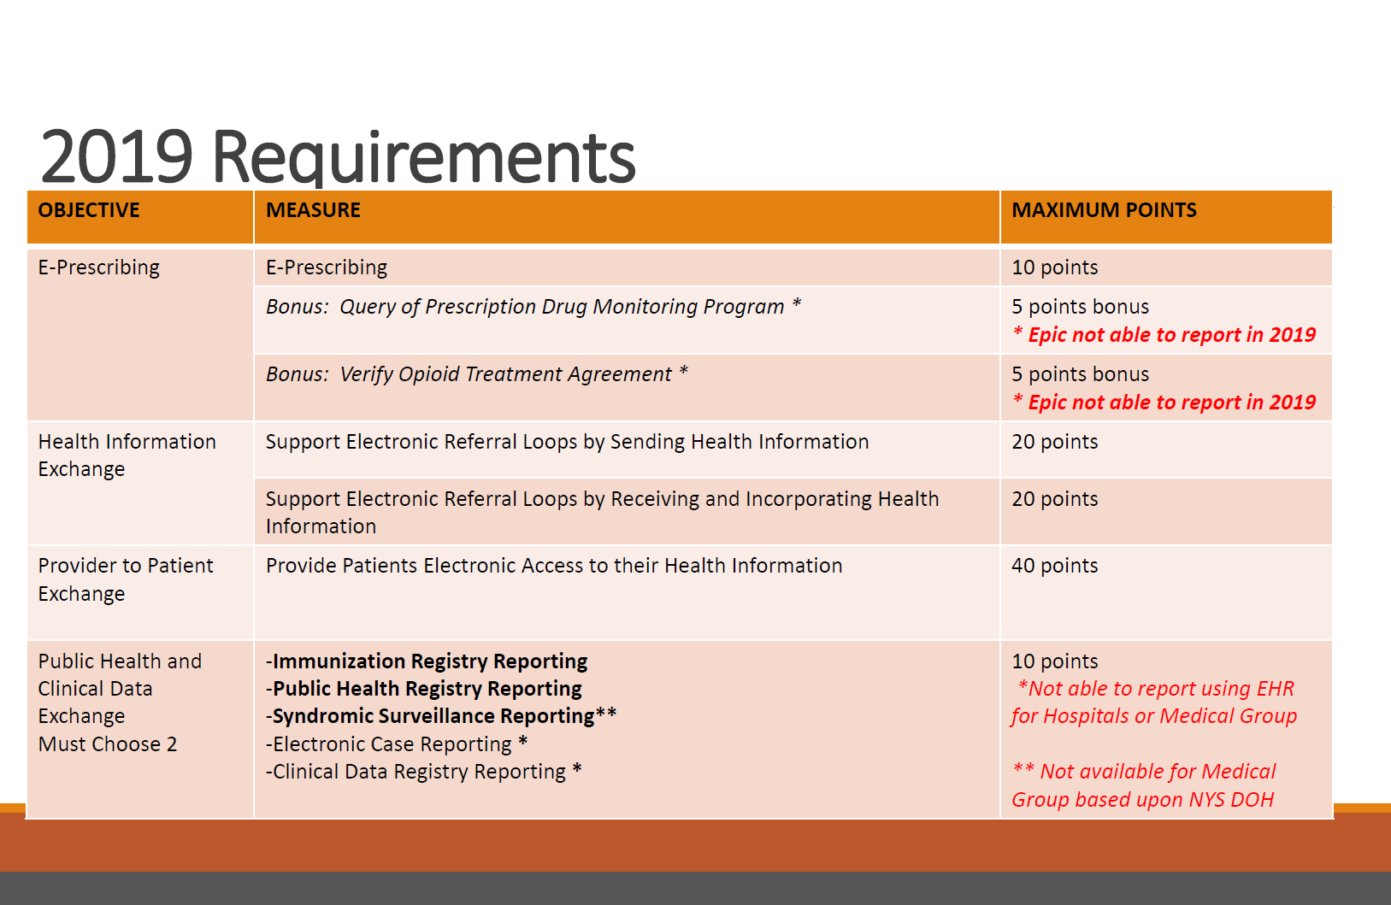
2019 Changes

Slide 44
2019 Changes
Must get at least 50 points to not have adjustment to IPPS lowered

Slide 45
2019 Changes
All eligible hospitals and eligible physicians were required to use 2015 edition Certified Electronic Health Record Technology (CEHRT)

Slide 46
2024 changes
Reporting period from 90 to 180 consecutive days
Antimicrobial Use and Resistance Surveillance Measure required
Attest “Yes” to SAFER guides

Slide 47
2024 changes
Objective | Measure | Maximum Points | Required/ Optional
Electronic Prescribing | ePrescribing | 10 | Required
 | Query PDMP | 10 | Required
Health Information Exchange | Sending Health Information -AND- | 15 | Required to choose 1 of 3 options
 | Receiving and Reconciling Health Information -OR- | 15
 | HIE Bi-Directional Exchange -OR- | 30
 | Enable Exchange under TEFCA | 30
Provider to Patient Exchange | Provide Patients Electronic Access to Health Information | 25 | Required

Slide 48
2024 changes
Public Health and Clinical Data Exchange |  | 25 | Required
 | Immunization Registry
 | Electronic Case Reporting
 | Electronic Reportable Labs
 | Antimicrobial Use & Resistance Surveillance
 | Public Health Registry | 5 Bonus points for 1 or both measures | Optional

